Slide 1
ARRAYS in JAVA

Slide 2
ARRAYS in JAVA
In general
Array is a fixed set of similar type of elements that are stored contiguous memory location
Java array is an object that contains elements of similar data type
It is a data structure which store similar type of elements

Slide 3
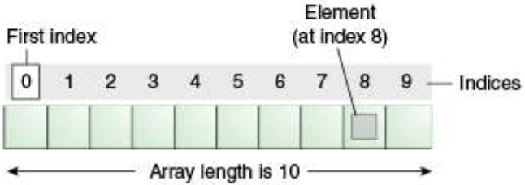
ARRAYS in JAVA
Array in java is index based
First element is stored at 0 index
Last element is stored at (n – 1)^{th} index

Slide 4
ARRAYS Advantages and Disadvantages
Advantages
Code Optimization
Data can be retrieved or sorted easily
Random access
Any data can be accessed located at any index position
Disadvantages
Size Limit
Only fixed number of elements can be stored
It doesn't grow its size at runtime

Slide 5
One Dimensional Array
Declaration
DataType[] arr ; or
DataType []arr ; or
DataType arr[] ; or
Instantiation of an Array
Dataype array[] = new Datatype [size] ;
Example
int marks[] = new int[5];
Declaration, Instantiation, and Initialization together
int a[] = {33,3,4,5};

Slide 6
Example :: One Dimensional Array
class Array_Example_1
{
public static void main(String args[])
{
int a[] = new int[3]; // Declaration and instantiation
a[0]=10; // Initialization
a[1]=20;
a[2]=70;
//printing array
for(int i = 0; i < a.length; i++) // Length is the property of array
System.out.println( a[i] );
}
}
Output:
10
20
70

Slide 7
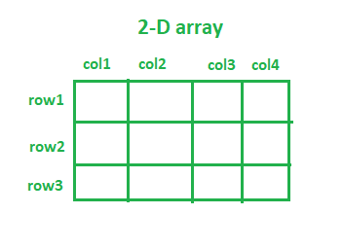
Two Dimensional Array
In such case, data is stored in row and column based index (also known as matrix form)
Syntax to Declare Multidimensional Array in java
dataType[][] arr ; or
dataType [][]arr ; or
dataType arr[][]; or
dataType []arr[] ;

Slide 8
Two Dimensional Array
Declaration and Instantiation
int[][] arr; or int[][] arr = new int[2][2] ;
Arr = new int[2][2];
Initialization
arr[0][0] = 1 ; arr[0][1] = 2 ; arr[1][0] = 3 ; arr[1][1] = 4 ;
Declaration, Instantiation and Initialization together
int[][] arr = { {1, 2}, {3, 4} };

Slide 9
Example :: Two Dimensional Array
class Array_example_3
{
public static void main(String args[])
{
int arr[][] = { {1, 2}, {3, 4} }; // Declaring and initializing 2D array
// Printing 2D array
for(int i = 0; i < 2; i++)
{
for(int j = 0; j < 2; j++)
{
System.out.print( arr[i][j] + “ ");
}
System.out.println();
}
}
}
Output:
1 2
3 4

Slide 10
Example :: Passing array to method
An array can be passed to a method
To reuse the same array for some task
class Array_Example_2
{
public void print_values ( int b[] )
{
for(int i = 0; i < b.length; i++)
System.out.println ( b[i] ) ;
}
public static void main(String args[])
{
int a[] = {33,3,4,5};
Array_Example_2 ae2 = new Array_Example_2 ( );
ae2.print_values ( a ); // Passing array to method
}
}

Slide 11
String in JAVA

Slide 12
String
In JAVA, a String is
A sequence of characters
Example:
“Hello” is a string of 5 characters
An immutable object
Means it is constant and cannot be changed once it has been created
Creating a String in JAVA
Two ways to create a String
By String literal
Using new keyword

Slide 13
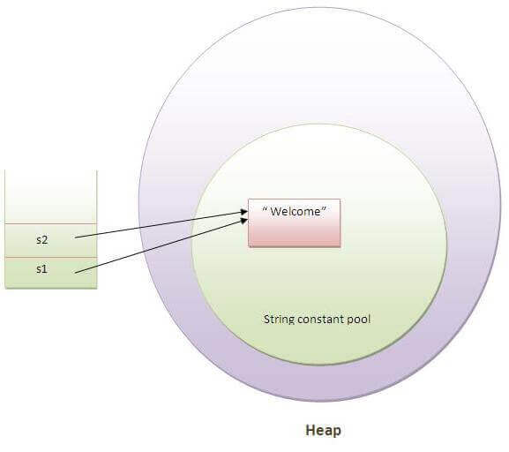
By String Literal
In JAVA
String literal is created
Using double quotes as:
String s1 = "welcome";
Here, JAVA
Creates the variable s1
Allocate space in the memory for the literal value “welcome”
This area in memory is called the string constant pool
Available to other parts of the program
If we create another variable, s2 with the same value “welcome”
Simply re-uses the value that's already in the pool
Makes JAVA more memory efficient
No new objects are created if it already exists in the string constant pool

Slide 14
Using new Keyword
In JAVA
String can also be created using new keyword as
String s1 = new String("welcome“);
Here, JAVA
Will create a new string object in normal heap memory (non-pool)
And the literal "Welcome" will be placed in the string constant pool
The variable s1 will refer to the object in a heap (non-pool)

Slide 15
Example of creating String
public class String_Example
{
public static void main(String args[])
{
String s1 = "java"; //creating string by string literal
char ch[] = {'s','t','r','i','n','g','s'};
String s2 = new String(ch); //converting char array to string
String s3 = new String("example"); //creating string by new keyword
System.out.println(s1);
System.out.println(s2);
System.out.println(s3);
}
}
Output:
java
strings
example

Slide 16
Java String class methods
The java.lang.String class provides many useful methods
To perform operations on sequence of char values
Method | Description
char charAt(int index) | returns char value for the particular index
int length() | returns string length
static String format(String format, Object... args) | returns a formatted string.
static String format(Locale l, String format, Object... args) | returns formatted string with given locale.
String substring(int beginIndex) | returns substring for given begin index.
String substring(int beginIndex, int endIndex) | returns substring for given begin index and end index.
boolean contains(CharSequence s) | returns true or false after matching the sequence of char value.
static String join(CharSequence delimiter, CharSequence... elements) | returns a joined string.
static String join(CharSequence delimiter, Iterable<? extends CharSequence> elements) | returns a joined string.

Slide 17
Java String class methods
boolean equals(Object another) | checks the equality of string with the given object.
boolean isEmpty() | checks if string is empty.
String concat(String str) | concatenates the specified string.
String replace(char old, char new) | replaces all occurrences of the specified char value.
String replace(CharSequence old, CharSequence new) | replaces all occurrences of the specified CharSequence.
static String equalsIgnoreCase(String another) | compares another string. It doesn't check case.
String[] split(String regex) | returns a split string matching regex.
String[] split(String regex, int limit) | returns a split string matching regex and limit.
String intern() | returns an interned string.

Slide 18
Java String class methods
int indexOf(int ch) | returns the specified char value index.
int indexOf(int ch, int fromIndex) | returns the specified char value index starting with given index.
int indexOf(String substring) | returns the specified substring index.
int indexOf(String substring, int fromIndex) | returns the specified substring index starting with given index.
String toLowerCase() | returns a string in lowercase.
String toLowerCase(Locale l) | returns a string in lowercase using specified locale.
String toUpperCase() | returns a string in uppercase.
String toUpperCase(Locale l) | returns a string in uppercase using specified locale.
String trim() | removes beginning and ending spaces of this string.
static String valueOf(int value) | converts given type into string. It is an overloaded method.

Slide 19
Data Type Conversions in Java
String to int
String str = "1050";
int num = Integer.parseInt(str); //return primitive
System.out.println(num);
Integer num = Integer.valueOf(str); //return object
System.out.println(num);
String to long
String longStr = "1456755";
long num = Long.parseLong(longStr); //return primitive
System.out.println(num);
Long num = Long.valueOf(longStr); //return object
System.out.println(num);

Slide 20
Data Type Conversions in Java
String to float
String floatStr = "49.78";
Float num = Float.parseFloat(floatStr); //return primitive
System.out.println(num);
Float num = Float.valueOf(floatStr); //return object
System.out.println(num);
String to double
String doubleStr = "99.378";
double num = Double.parseDouble(doubleStr); //return primitive System.out.println(num);
Double num = Double.valueOf(doubleStr); //return object System.out.println(num);
Strings can be converted to Boolean and date also

Slide 21
To do: Some Programming
Write a program in java to count and print the reverse a given String
Write a program in java to check if a given String is Palindrome or not
Write a program in java to remove a given character from String
Write a program in java to concatenate and compare two strings
Write a program in java to find if a substring is present in a given string or not
Write a program in java to count the number of words in String

